Slide 1
iSupplier Portal
Information pack

Slide 2
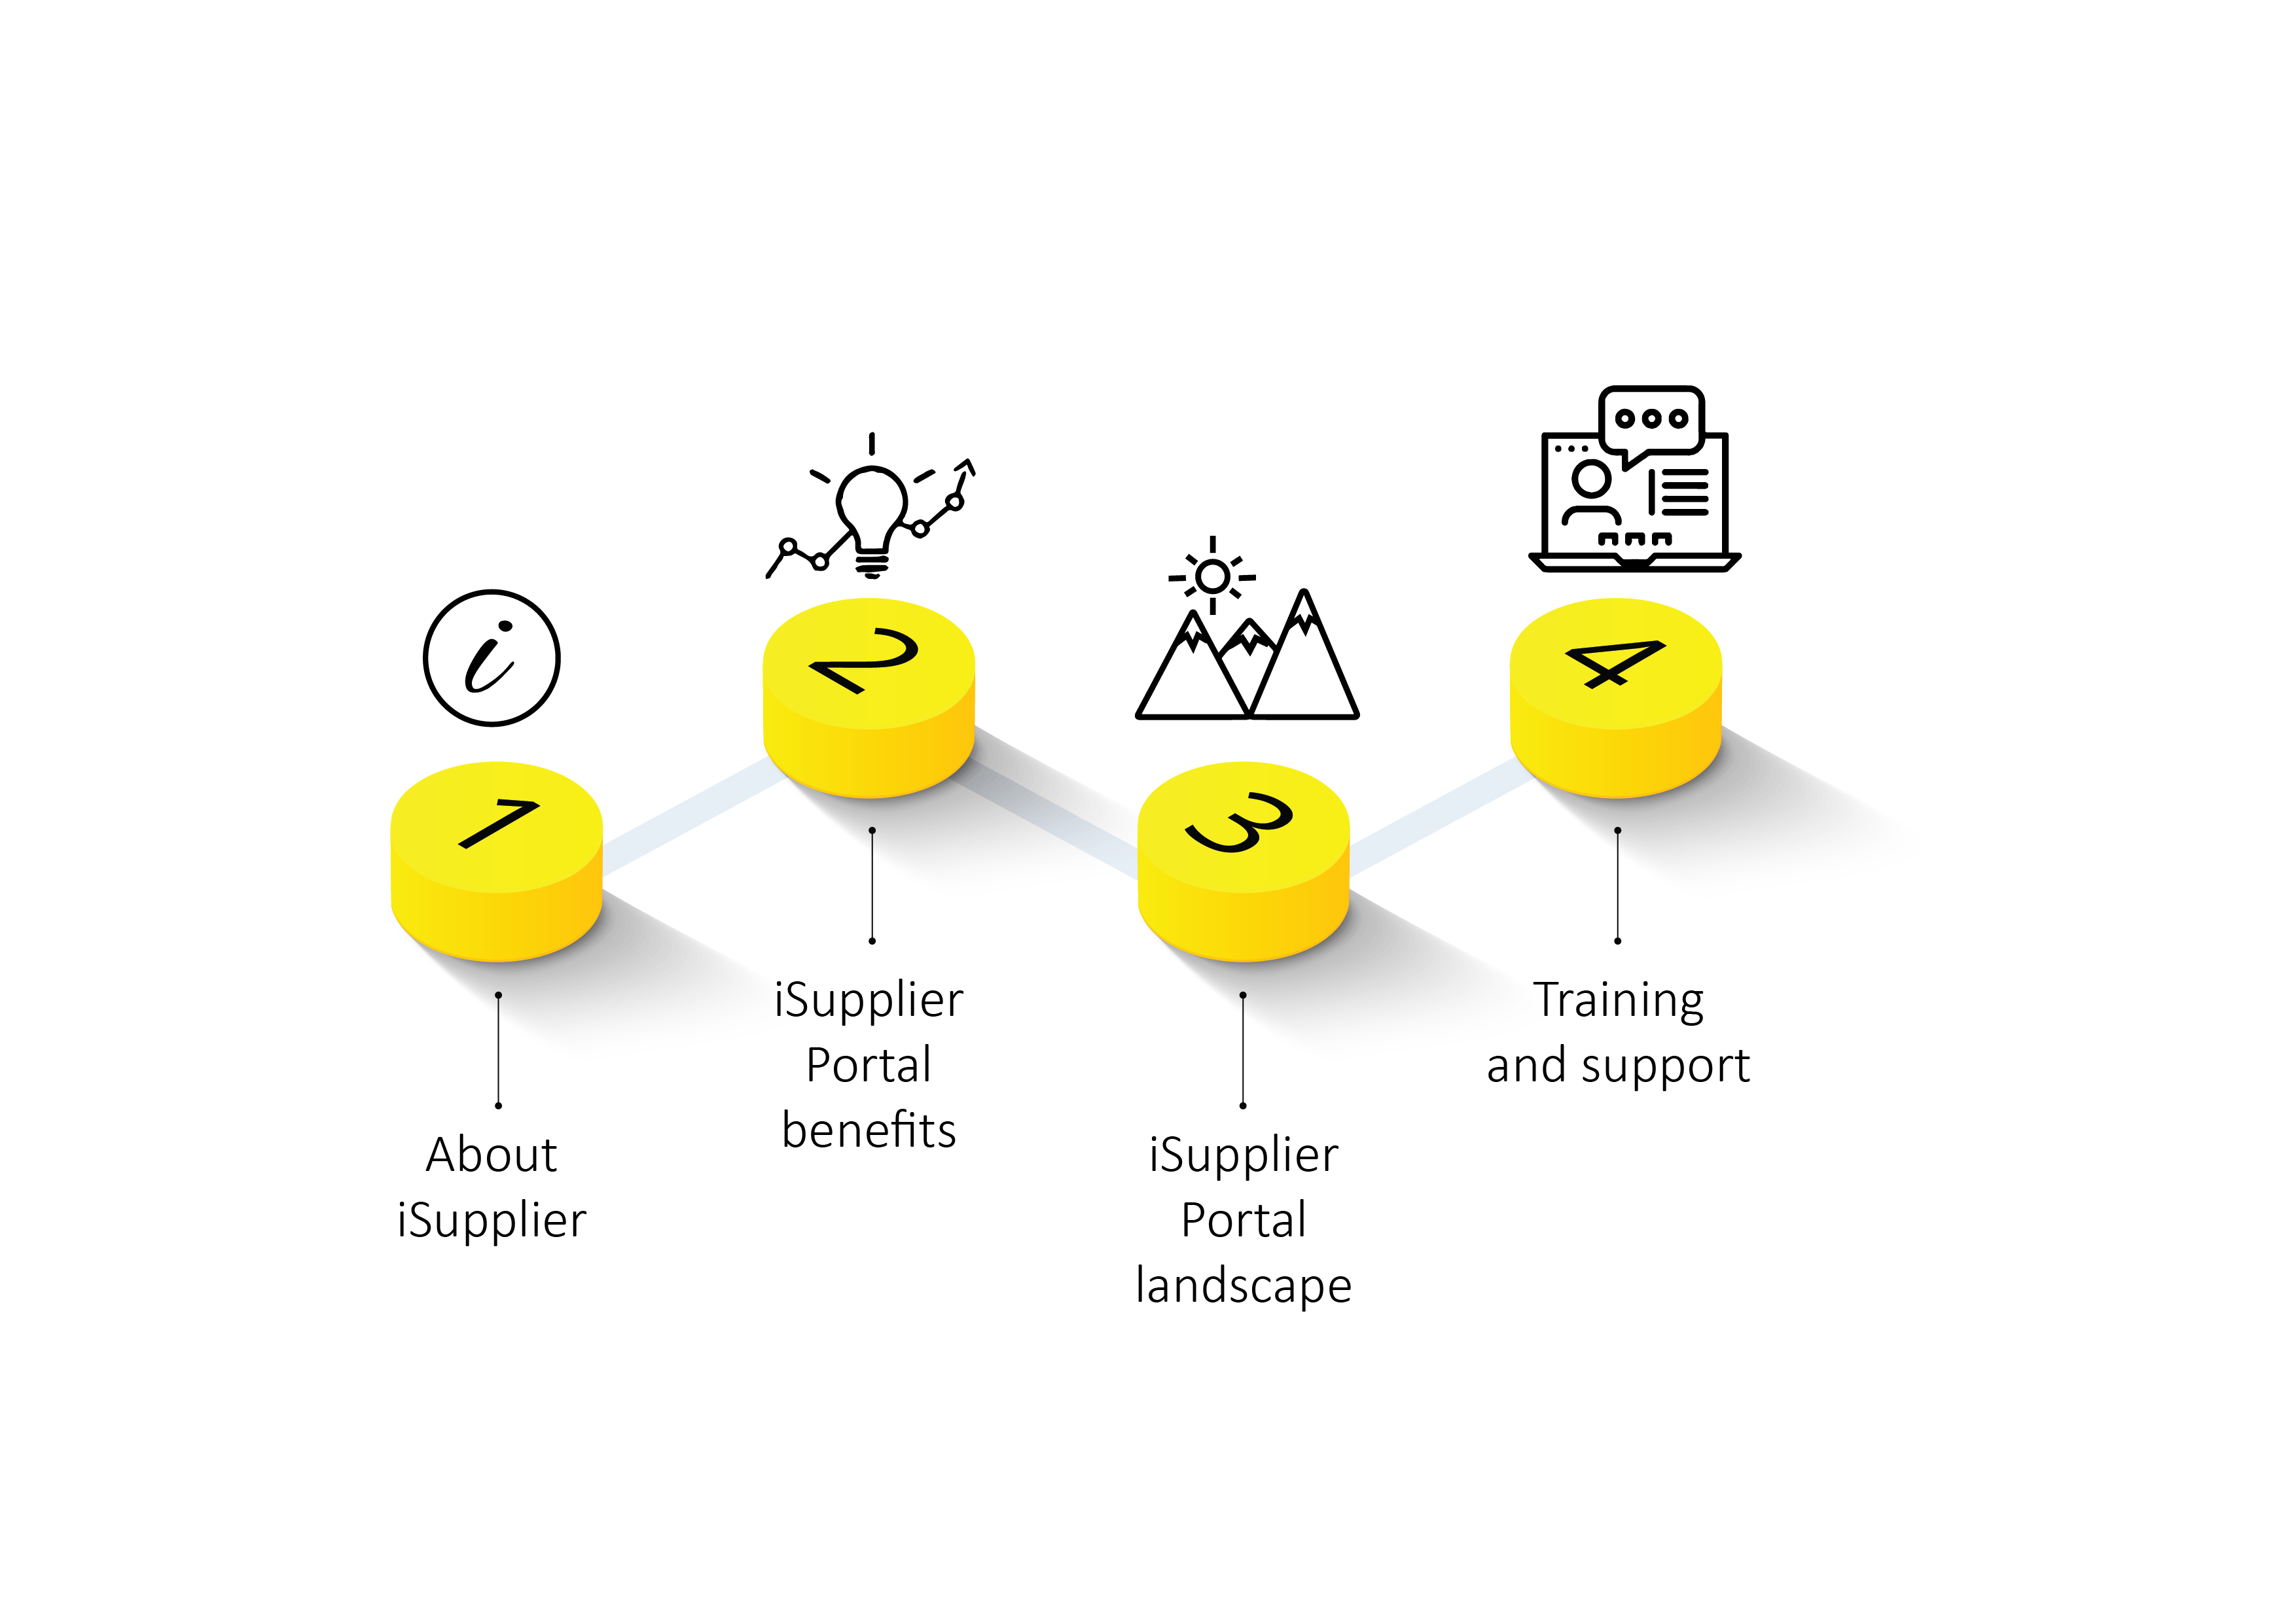
OVERVIEW

Slide 3

About iSupplier
ABOUT
The iSupplier module is part of the Oracle E-Business Suite (EBS) application. This application enables effective interaction between the South African Reserve Bank (SARB) and its suppliers. It also reduces the workflow cycle by automating processes that were previously manual in nature. The application allows suppliers to perform many actions, such as to register and manage their profile, view details of purchase orders (POs), send invoices and view the status of transactions online.
The iSupplier module will reduce the effort incurred by the SARB when manually capturing invoices and processing documents and actual payment(s), while allowing for transparency between suppliers and the SARB. The portal will also enable the SARB and its suppliers to interact online by exchanging documents and completing transactions, thereby improving communication.

Slide 4
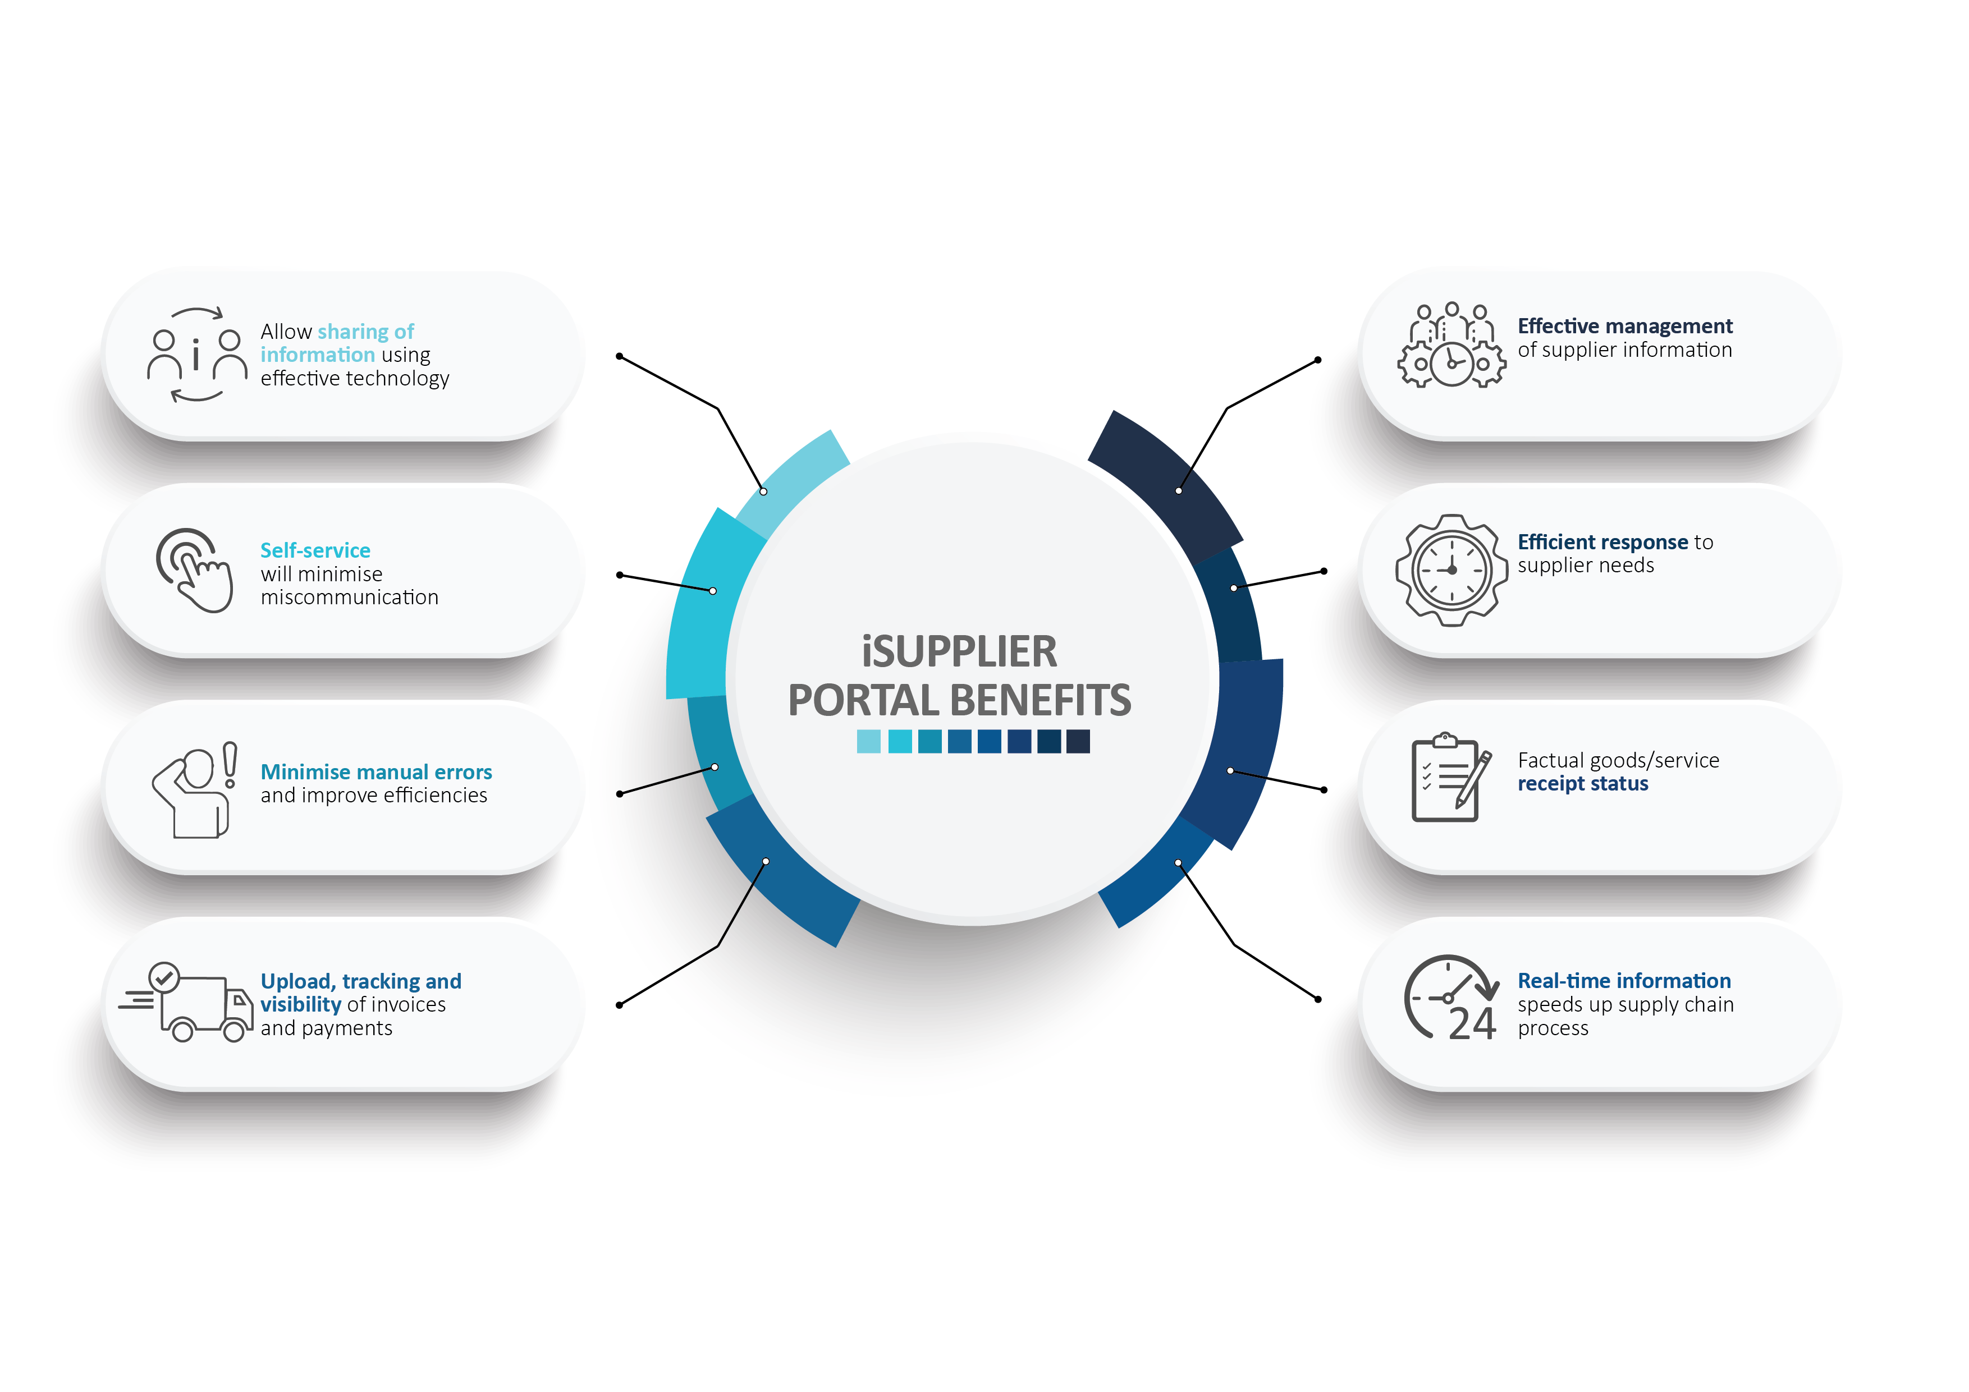

PORTAL
BENEFITS

Slide 5
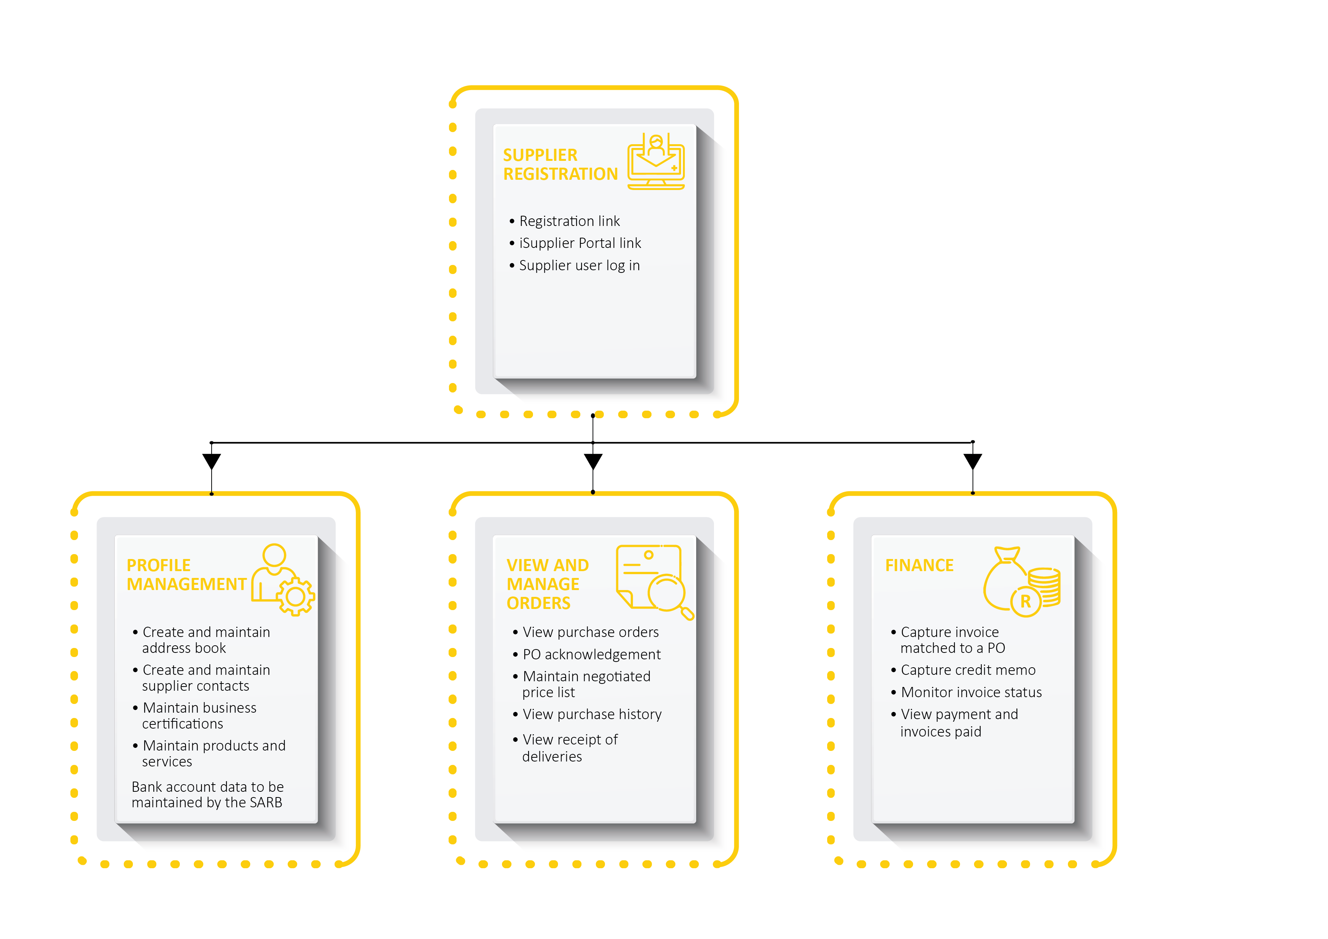

iSupplier
Landscape
LANDSCAPE

Slide 6
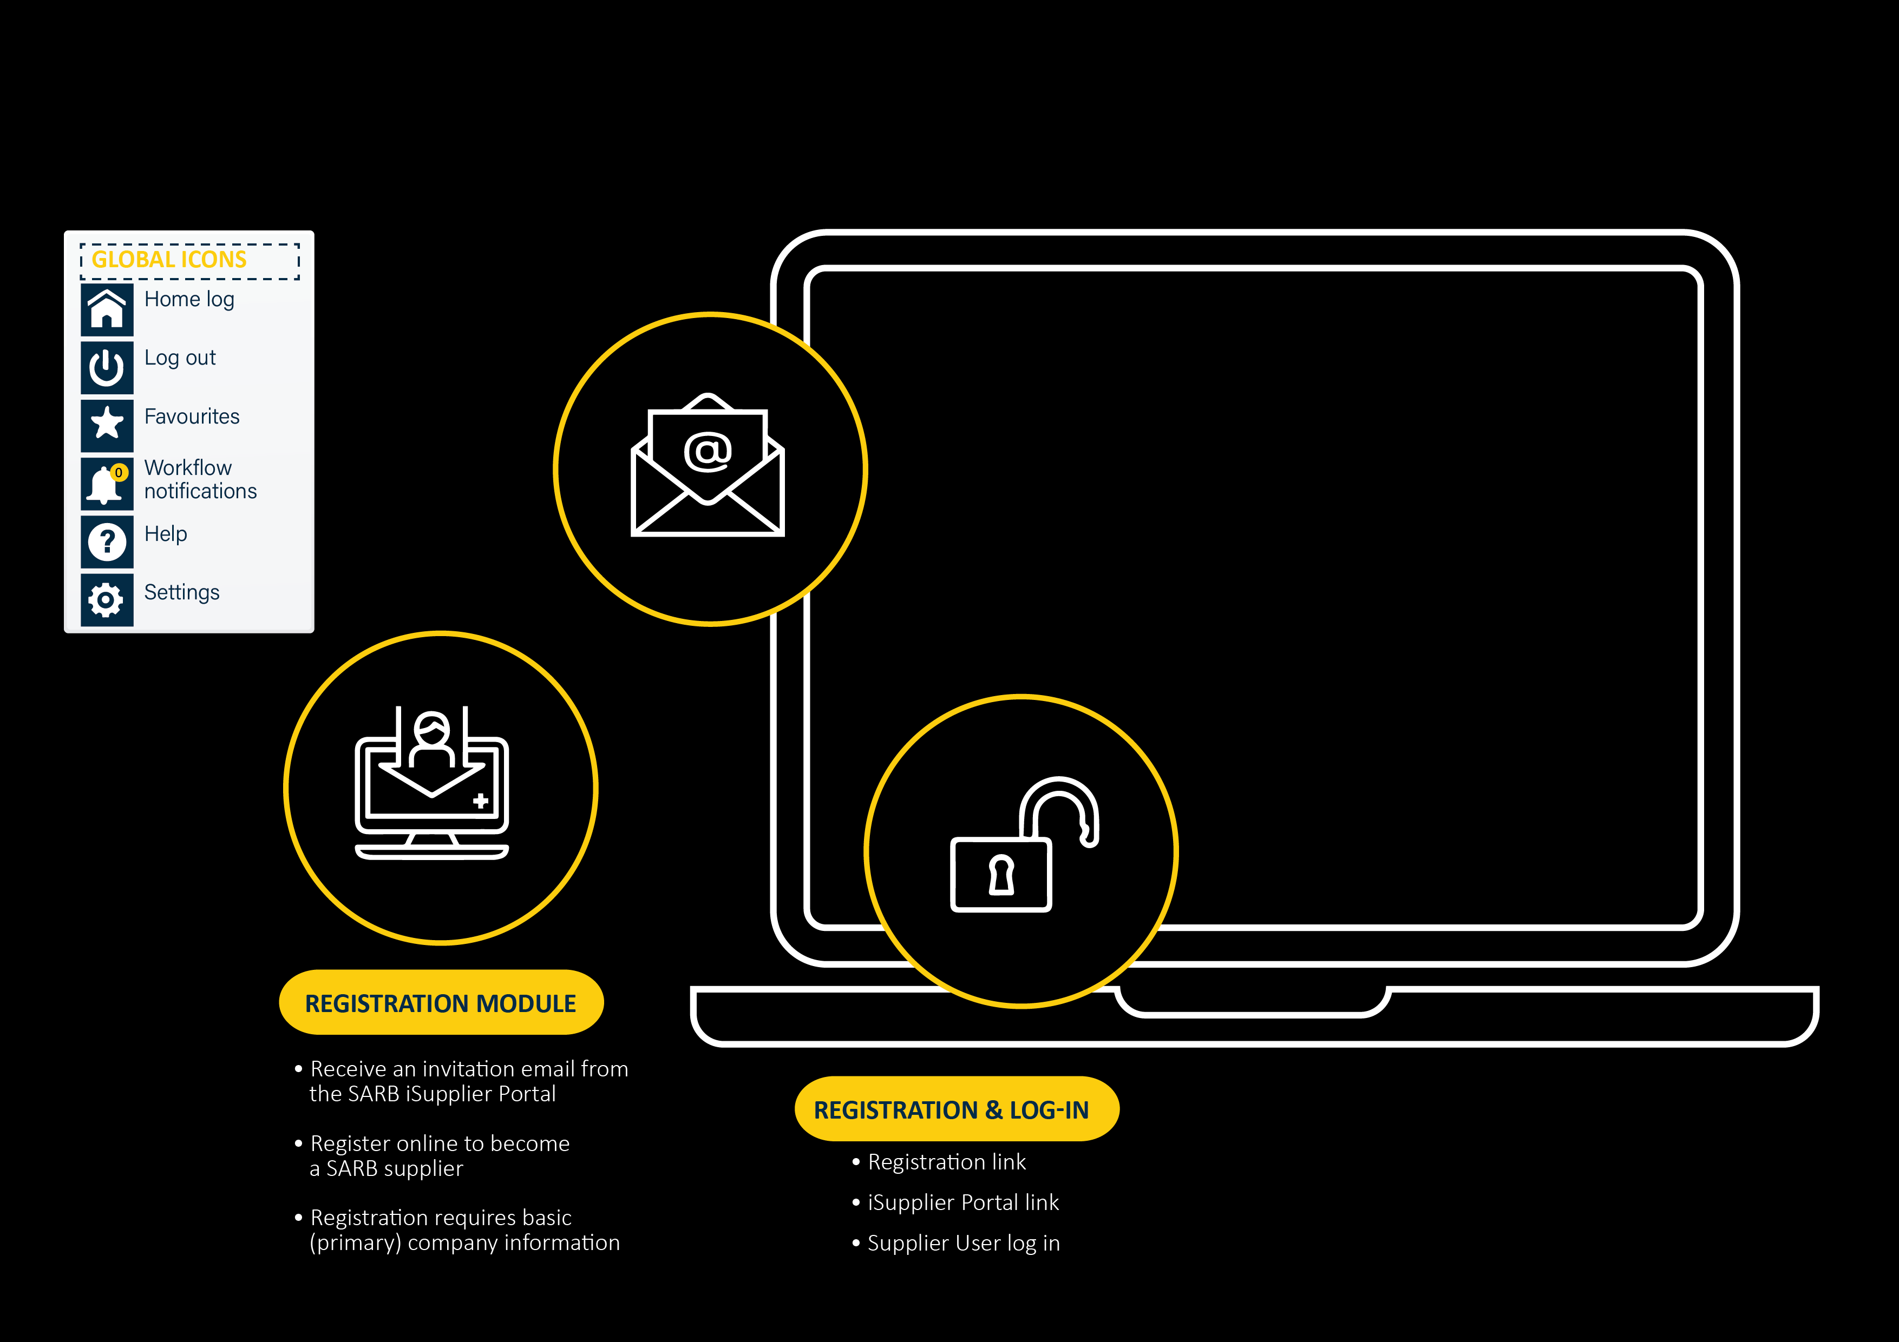
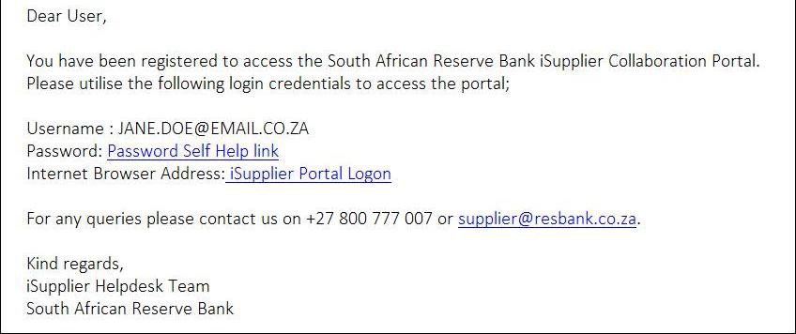
Supplier registration
REGISTRATION

Slide 7
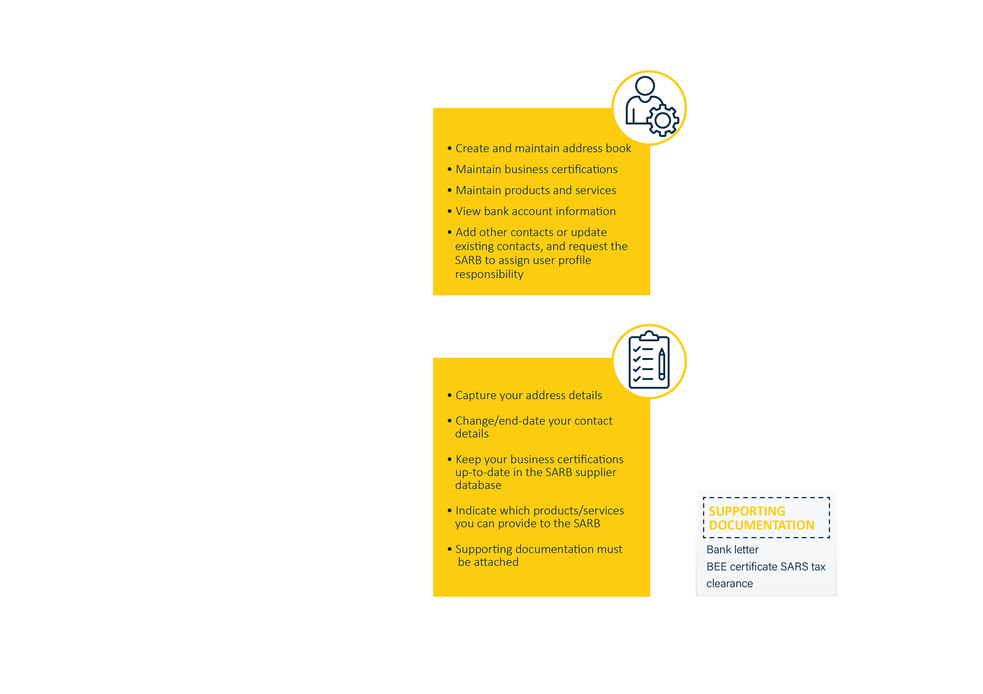
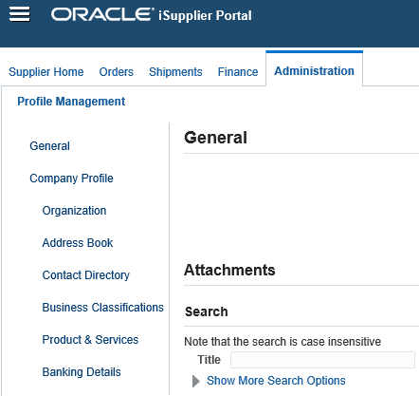

iSupplier core theme
iSupplier core theme

Slide 8
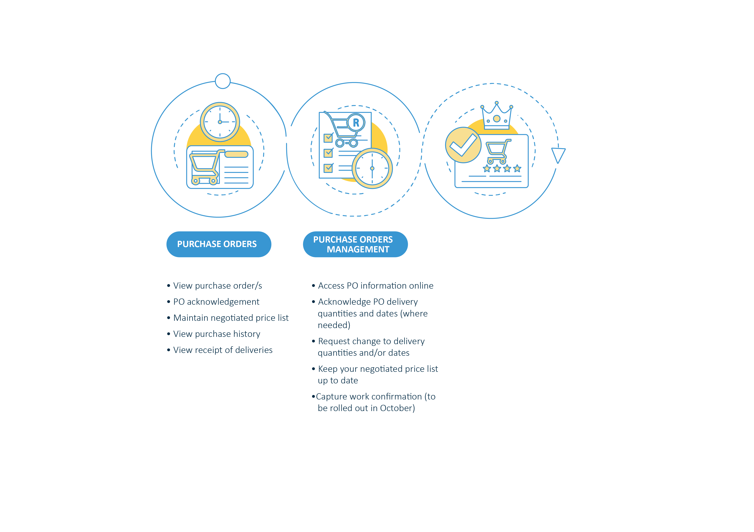
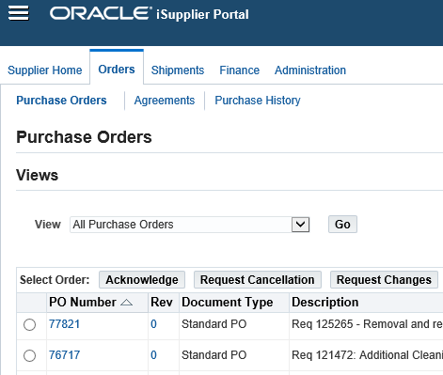
View and manage orders
View and manage orders

Slide 9
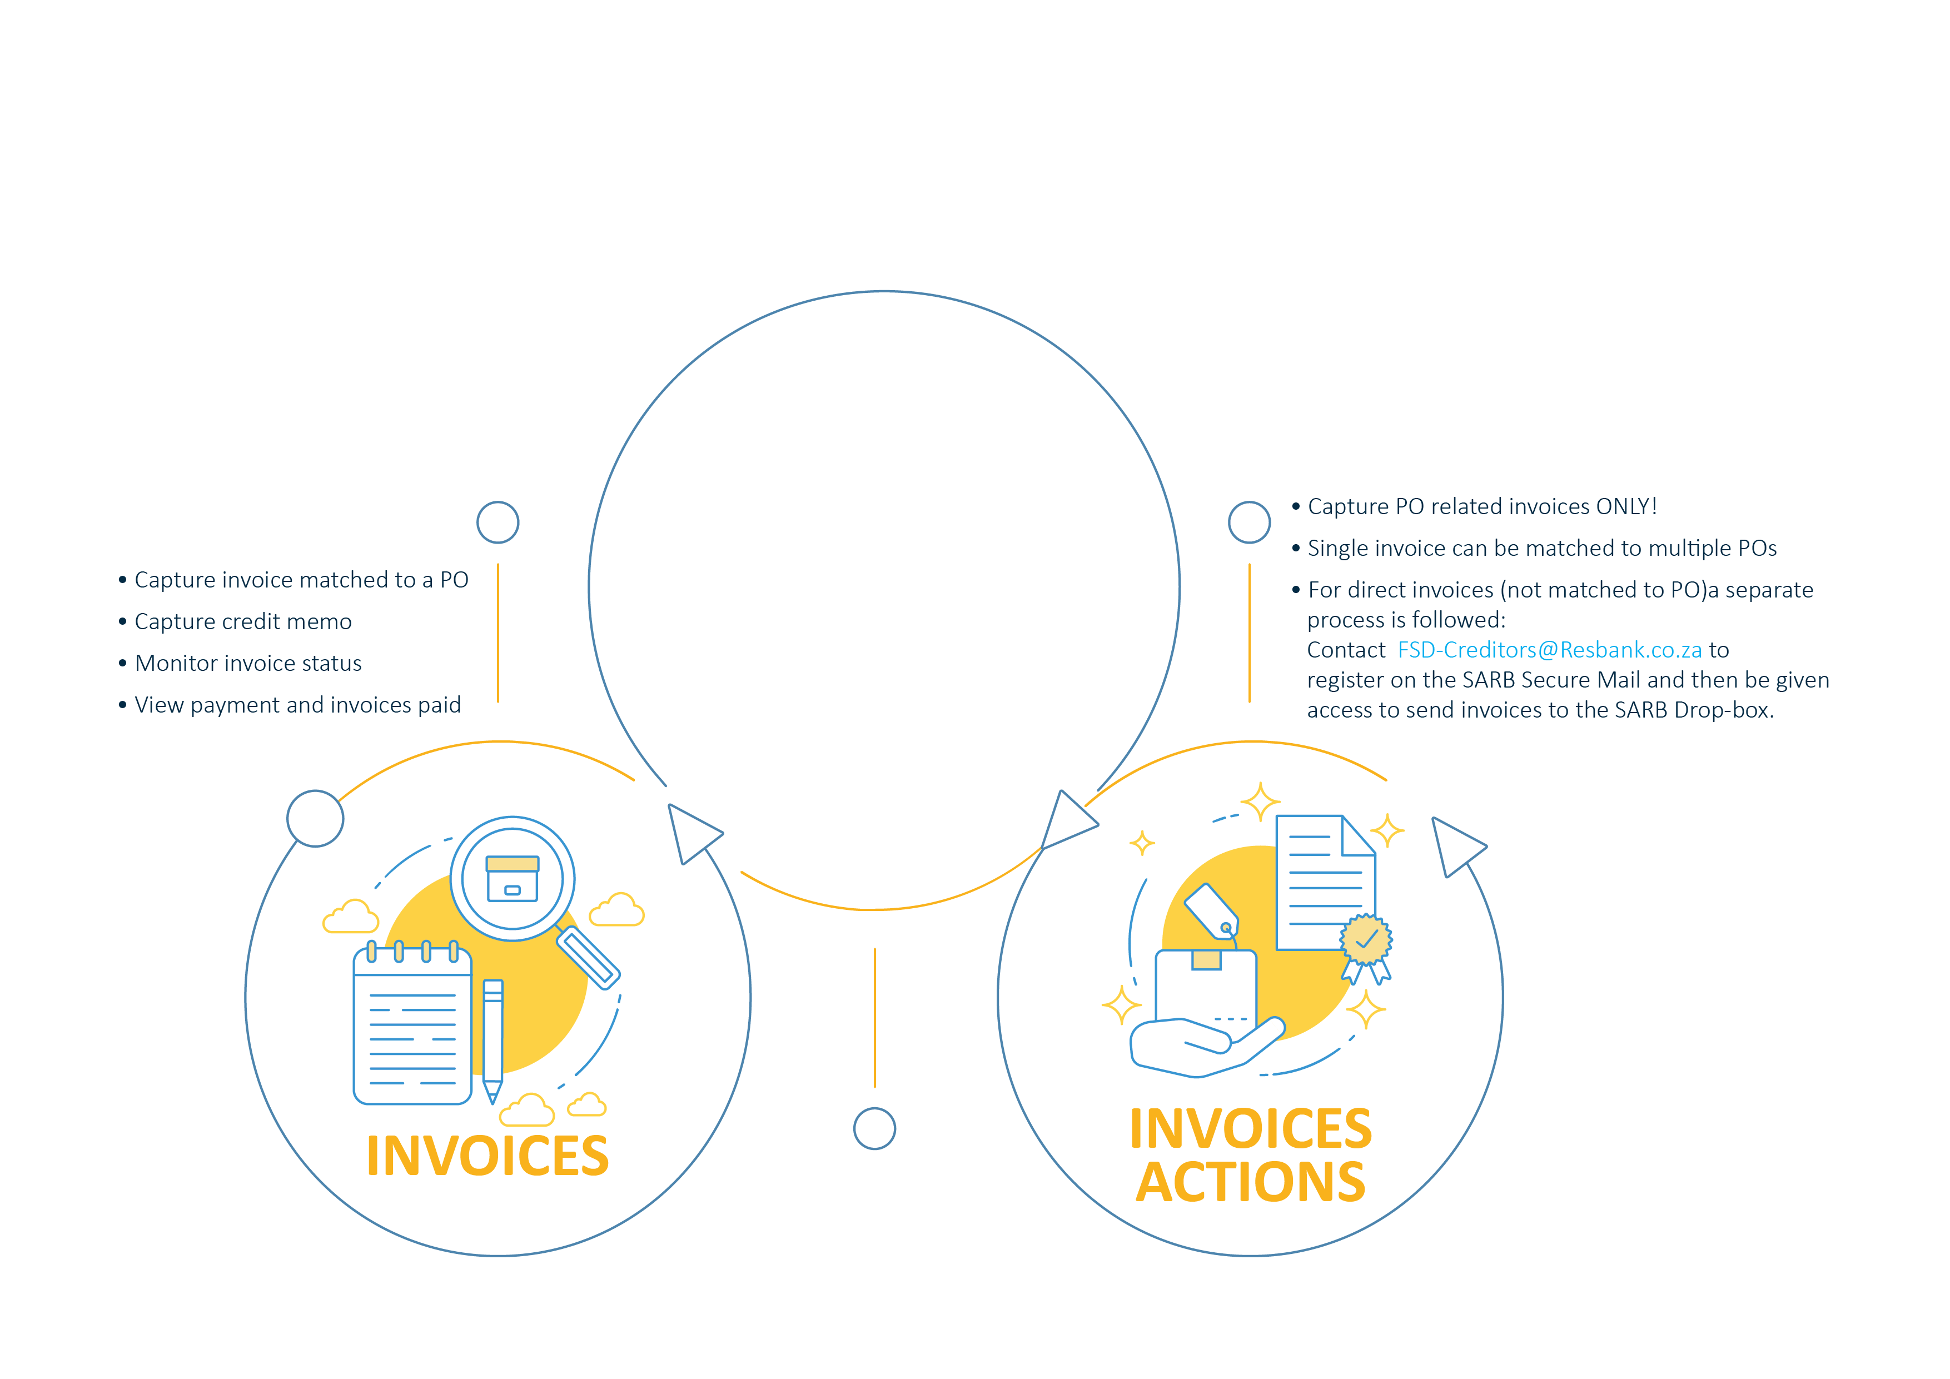
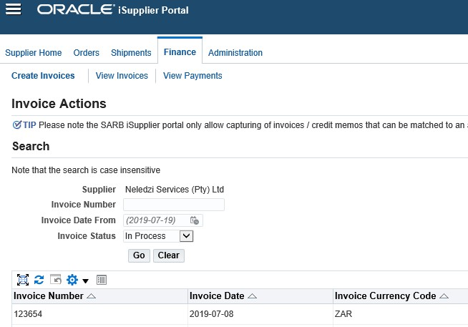
Finance
Finance

Slide 10
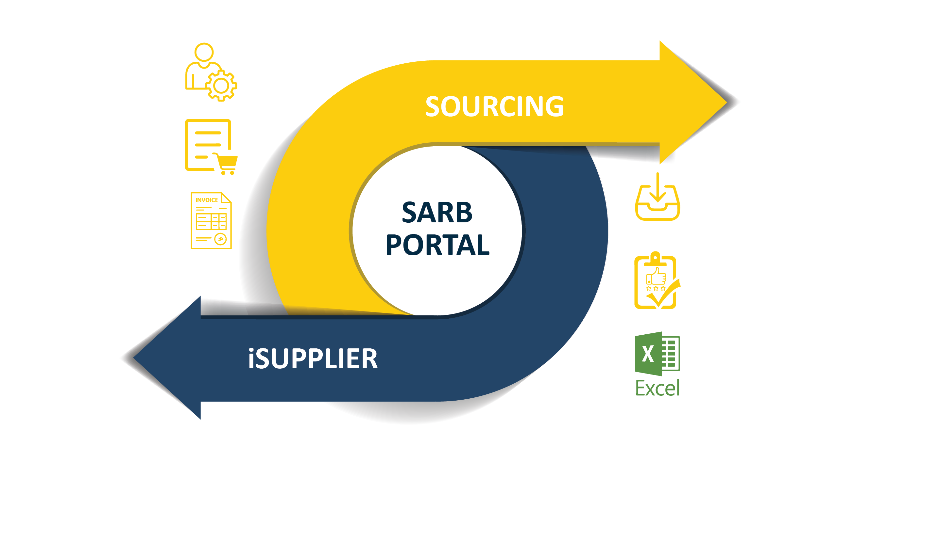
iSupplier roles and interface to eSourcing
eSourcing

Slide 11

Training and support
USER GUIDE
VIDEOS & E-LEARNING (Under development)
QUICK REFERENCE GUIDE, FREQUENTLY ASKED QUESTIONS (FAQs)
SARB HELPDESK
supplier@resbank.co.za
+27 800 777 007

